Slide 1


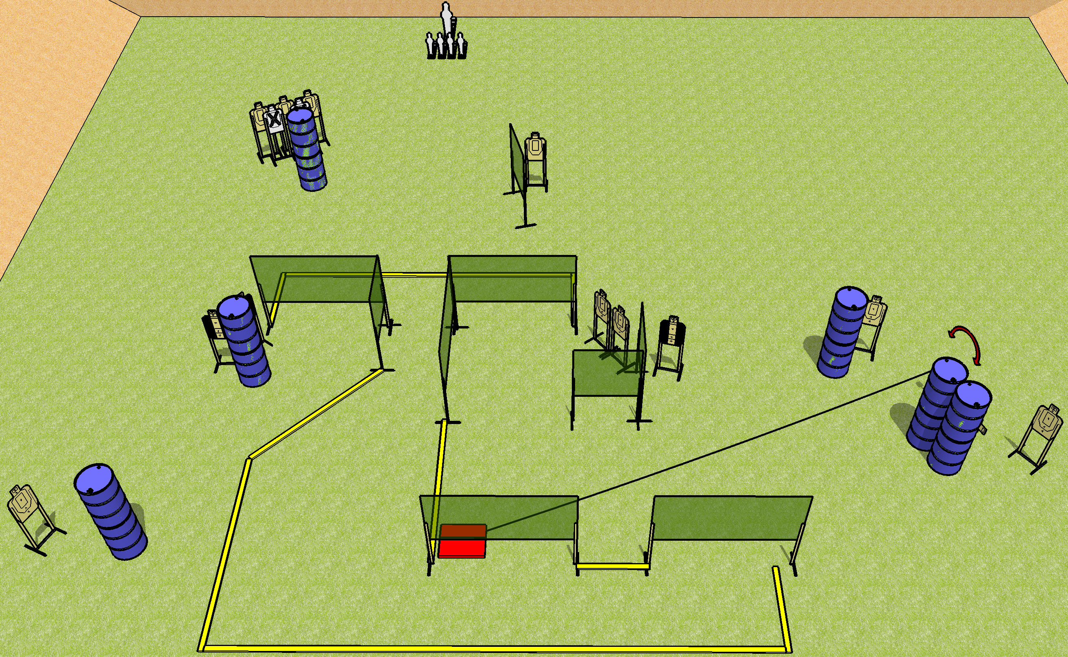
 | Dothan Gun Club – USPSA Match Step on the Box Course Designer : Drew Coleman
Round Count 31 rounds 13 USPSA 4 minis, 1 pepper popper
Equipment List 13 wall feet 4 medium fault lines Stomp box + activator 3 Tuxedos

Slide 2
Step on the Box
Written Stage Briefing
Step on the Box is a 31 round, 155 point, Comstock course of fire. There are 13 USPSA targets, 4 mini poppers, and 1 pepper popper. The best 2 hits on paper will score, and steel must fall to score. The start signal is audible.
The swinger is activated by the stomp box and is visible at rest. The stomp box is NOT part of the shooting area. Please check the activator prior to walkthrough and set it the same way every time.
Handgun start position is anywhere inside the shooting area, wrists below belt. Handgun is loaded and holstered.
PCC start position is anywhere inside the shooting area, stock on belt. Carbine is loaded, safety on.
On start signal, engage targets as they become available from within the shooting area.

